Slide 1

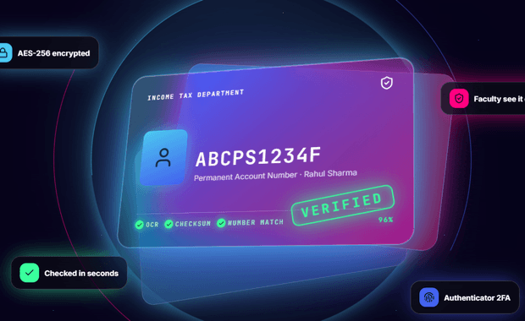


PSG COLLEGE OF TECHNOLOGY, COIMBATORE
Department of Computer Applications · MCA First Year
26MX17 Web Application Development · Review 1
TrustVault
Smart Digital Identity and Document Verification Portal for college students and faculty
PROJECT GUIDE
Dr. N. Ilayaraja
TEAM MEMBERS
KIRUBHAKARAN K
POOJA M
SRINITHISH J K
AES-256-GCM
3-factor sign-in
SHA-256 ledger
26MX325
26MX337
26MX347 · Presenting
Live: trustvault-5lgg.onrender.com
Notes:
Good morning. We are Kirubhakaran K, Pooja M and Srinithish J K from 26MX, and our project for 26MX17 Web Application Development is TrustVault, a smart digital identity and document verification portal for college students and faculty, guided by Dr. N. Ilayaraja. Srinithish J K is presenting this review.

Slide 2



Acknowledgement
WITH GRATITUDE
We thank the following for their guidance, encouragement and support throughout this project.
HEAD OF THE DEPARTMENT
MCA PROGRAMME COORDINATOR
GUIDE AND REVIEW PANEL
Dr. N. Ilayaraja
Ms. A. Kalyani
Review panel members
Department of Computer Applications, PSG College of Technology
For coordinating the programme and the project reviews
Our guide Dr. N. Ilayaraja and the panel, for their suggestions and feedback
— Kirubhakaran K, Pooja M and Srinithish J K
Notes:
We thank our Head of the Department, Dr. N. Ilayaraja; our MCA Programme Coordinator, Ms. A. Kalyani; and our faculty guide and the review panel members for their guidance and suggestions.

Slide 3
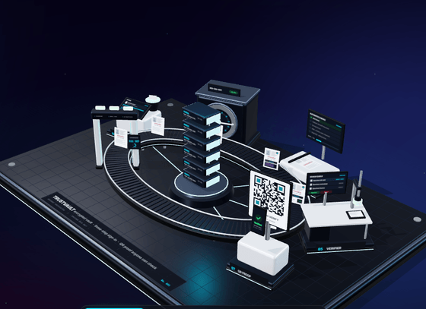





Project Overview
THE PROJECT
A secure, college-exclusive vault for MCA students’ identity and academic documents
Three-factor sign-in (password, email code, Google Authenticator) plus a vault PIN
Every file encrypted with AES-256-GCM; document numbers are masked on screen
Automatic checks on upload: format, Aadhaar checksum, OCR and signs of editing
Faculty request documents from a student or a batch; students share all, some or none
Main page 3D vault Built with Three.js: each document rides past every check station
Each shared document opens once in 24 hours; every action is sealed in a SHA-256 ledger
Notes:
TrustVault is a secure web application in which MCA students keep their identity and academic documents in one encrypted vault and share them with faculty only with their consent. On the right is the 3D vault from our main page: each document passes every check station.

Slide 4
Analysis of the Existing System
WHERE WE STAND
DigiLocker
NAD
Google Drive
Parchment
INDIA
INDIA
GLOBAL
GLOBAL
FEATURES
FEATURES
FEATURES
FEATURES
Government documents from issuers
Legally valid digital copies
Degrees and marksheets from universities
Online verification for employers
Stores and shares any file
Free and familiar to students
Issues official digital transcripts
Receivers can verify credentials
MISSING
MISSING
MISSING
MISSING
No faculty request or consent flow
Self-uploaded files not verified
Academic awards only, no ID documents
No batch requests or one-time access
Cannot tell if a document is genuine
Links can be forwarded; no audit trail
Mainly US institutions; paid
No student vault for ID documents
TrustVault fills these gaps: college-exclusive, consent-based, automatically verified and tamper-evident.
Notes:
We studied four existing systems, two Indian and two global. Each does part of the job, but none gives a college a consent-based, automatically verified and tamper-evident document flow between students and faculty.

Slide 5





Tools and Technologies
OUR STACK
Frontend
Backend
Database
Authentication
React 19, Vite, Tailwind CSS, shadcn/ui and Three.js for 3D
Node.js with an Express 5 REST API
MongoDB with Mongoose: users, documents, requests, ledger, audit log
bcrypt passwords, email OTP, Google Authenticator (TOTP), JWT
Security
Document checks
Deployment
Testing
AES-256-GCM encryption, SHA-256 ledger, Helmet, rate limiting
Tesseract.js OCR, Sharp and pdf-lib for images and PDFs
Render hosting, GitHub Actions CI/CD, Capacitor Android app
Node.js test runner, end-to-end and browser UI tests on every change
Notes:
The frontend is React 19 with Vite and Tailwind CSS; the backend is Node.js with Express 5 and MongoDB. Sign-in uses bcrypt, email codes, Google Authenticator and JWT; files are encrypted with AES-256-GCM and checked with Tesseract OCR. It is hosted on Render with GitHub Actions CI/CD and ships as an Android app with Capacitor.

Slide 6


Major Entities and their Roles
WHO USES IT
Student
Faculty (Verifier)
Administrator
TrustVault System
Registers with a valid MX roll number
Uploads and manages documents in the vault
Approves or denies faculty requests
Joins with a department code or invitation
Requests documents from a student or batch
Opens each shared document once
Manages users, roles and invitations
Reviews requests and the audit log
Cannot open students’ files
Encrypts and fingerprints every file
Runs the automatic verification checks
Seals each action in the hash-chained ledger
DATA ENTITIES
Users
Documents
Access requests
Ledger blocks
Audit log
Name, roll number, role, 2FA and PIN hashes
Type, masked number, SHA-256, status, check score
Who asked, types asked and shared, 24 h expiry
File hash, previous hash and block hash
Who did what, to whose data, and when
Notes:
Three kinds of people use TrustVault: students, faculty who act as verifiers, and the administrator. The system itself is the fourth actor: it encrypts, checks and records everything. Below are the five main collections in our MongoDB database.

Slide 7


Major Functionalities of the System
WHAT IT DOES
01
02
03
Registration and sign-in
Encrypted document vault
Automatic verification
Students sign up with a valid MX roll number; sign-in needs password, email code and Authenticator
Upload, view and delete documents in Identity, Academic and Other; a PIN unlocks the vault
Format, checksum, OCR and originality checks score out of 100; failed checks are shown
04
05
06
Requests and consent
Administration and audit
Notifications and export
Faculty ask one student or a batch; the student shares all, some or none; each opens once in 24 h
Users, roles and invitations, the audit log and a ledger integrity check that spots any change
Email alerts for new devices, requests and views; export as a password-protected ZIP
Notes:
These are the six main functions: sign-up and three-factor sign-in, the encrypted vault, automatic verification, faculty requests with student consent, administration with a tamper-evident audit, and notifications with secure export.

Slide 8
Work Flow of the Project
HOW IT FLOWS
SECURE UPLOAD
1
2
3
4
5
Sign up
Sign in
Unlock vault
Upload
Auto checks
Valid MX roll number or staff code
Password, email code, Authenticator
With the 6-digit vault PIN
AES-256-GCM encrypted, SHA-256 hashed
Verified only if all pass; sealed in ledger
CONSENT-BASED ACCESS
6
7
8
9
10
Faculty request
Student notified
Consent
One-time access
Audit trail
One student or a whole batch
By email and in the app
Share all, some or none
Each document opens once in 24 h
Every view is logged for the admin
Notes:
The work flow has two phases. First, a secure upload: the student signs up, signs in with three factors, unlocks the vault, uploads, and the document is encrypted and checked. Second, consent-based access: faculty request, the student is notified and decides, the faculty member opens each shared document once, and every view goes into the audit trail.

Slide 9
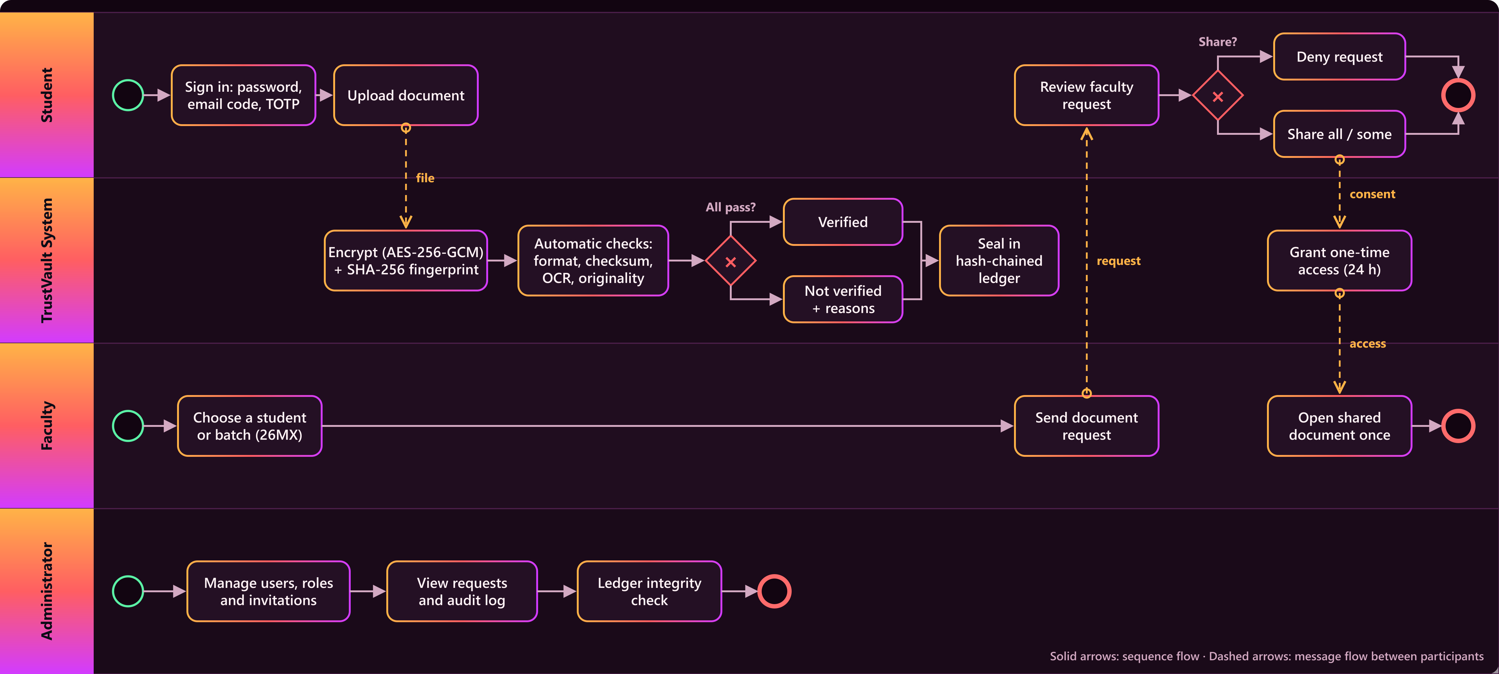
BPMN Diagram of the Project
BPMN MODEL
Notes:
This BPMN diagram has four lanes: student, the TrustVault system, faculty and administrator. Solid arrows are the sequence flow inside each lane; dashed arrows are messages between them: the uploaded file, the faculty request, the student’s consent and the one-time access.

Slide 10
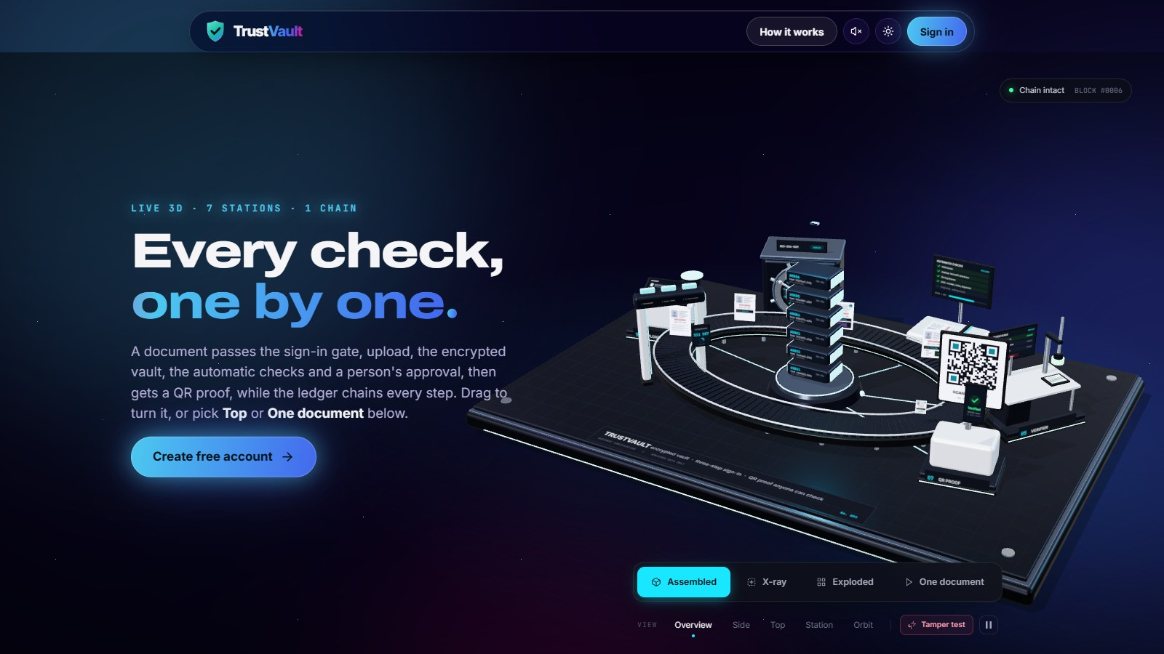
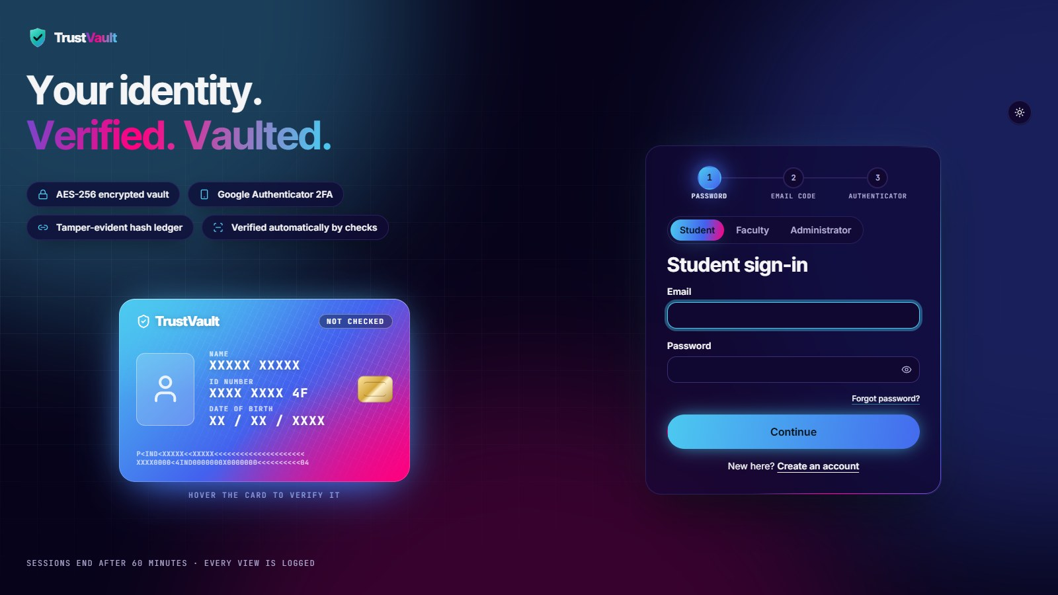
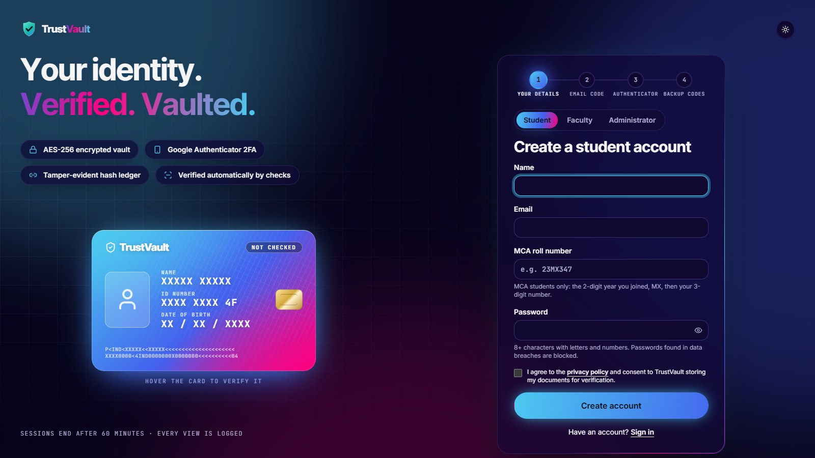
All UI Pages of the Project
THE INTERFACE · PUBLIC PAGES · 1 OF 4
Sign-in student, faculty and admin tabs
Main page live 3D vault, kinetic headline and every check explained
Sign-up MX roll number check and consent
Notes:
Public pages: Main page, live 3D vault, kinetic headline and every check explained; Sign-in, student, faculty and admin tabs; Sign-up, MX roll number check and consent. These are screenshots of the running application.

Slide 11
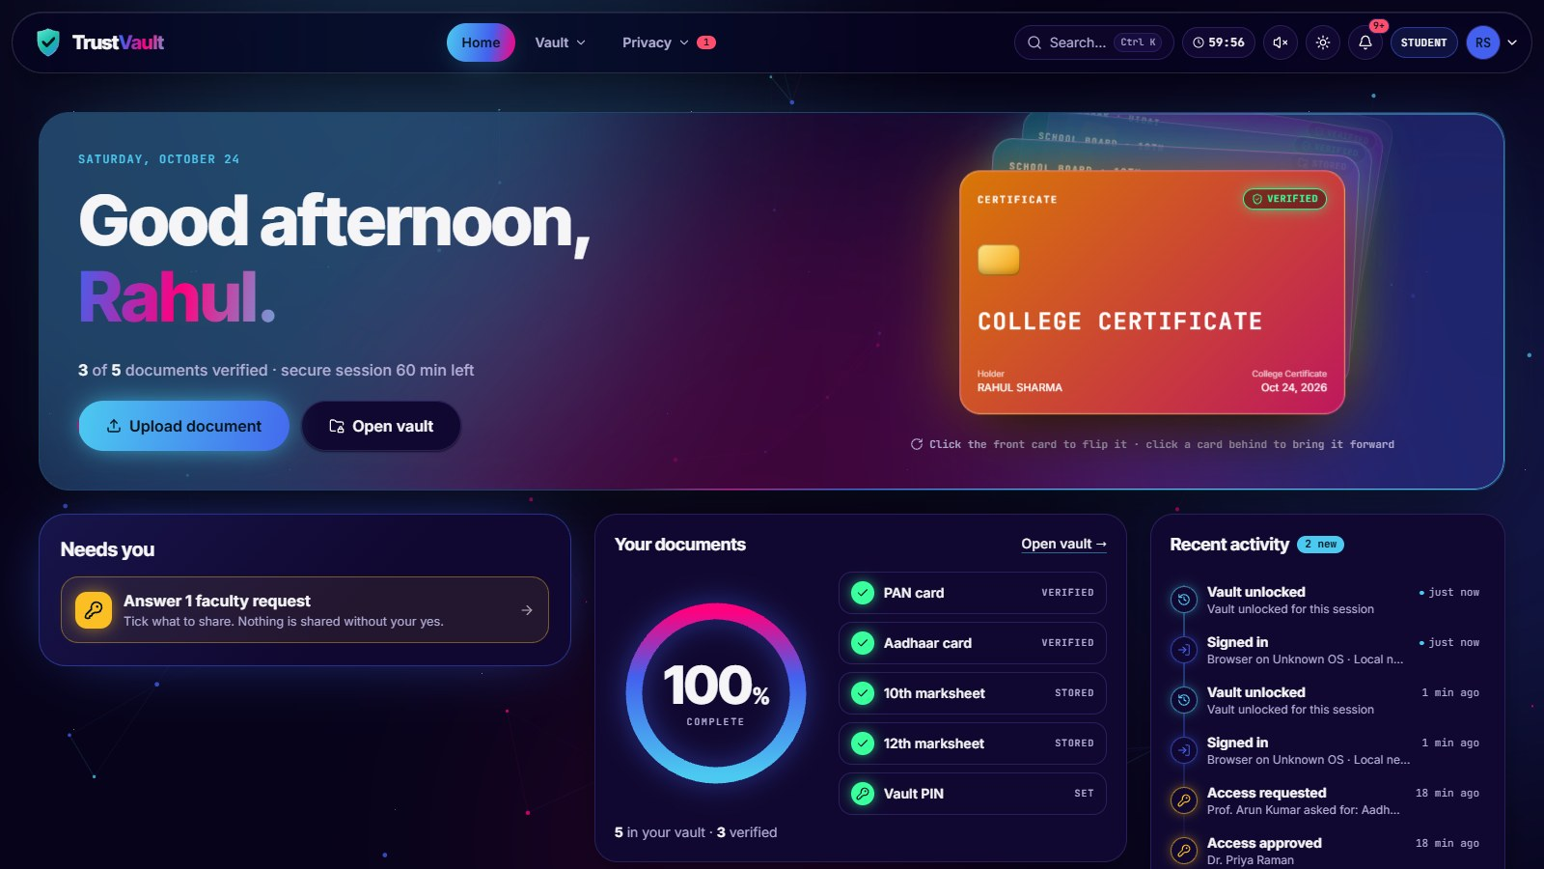
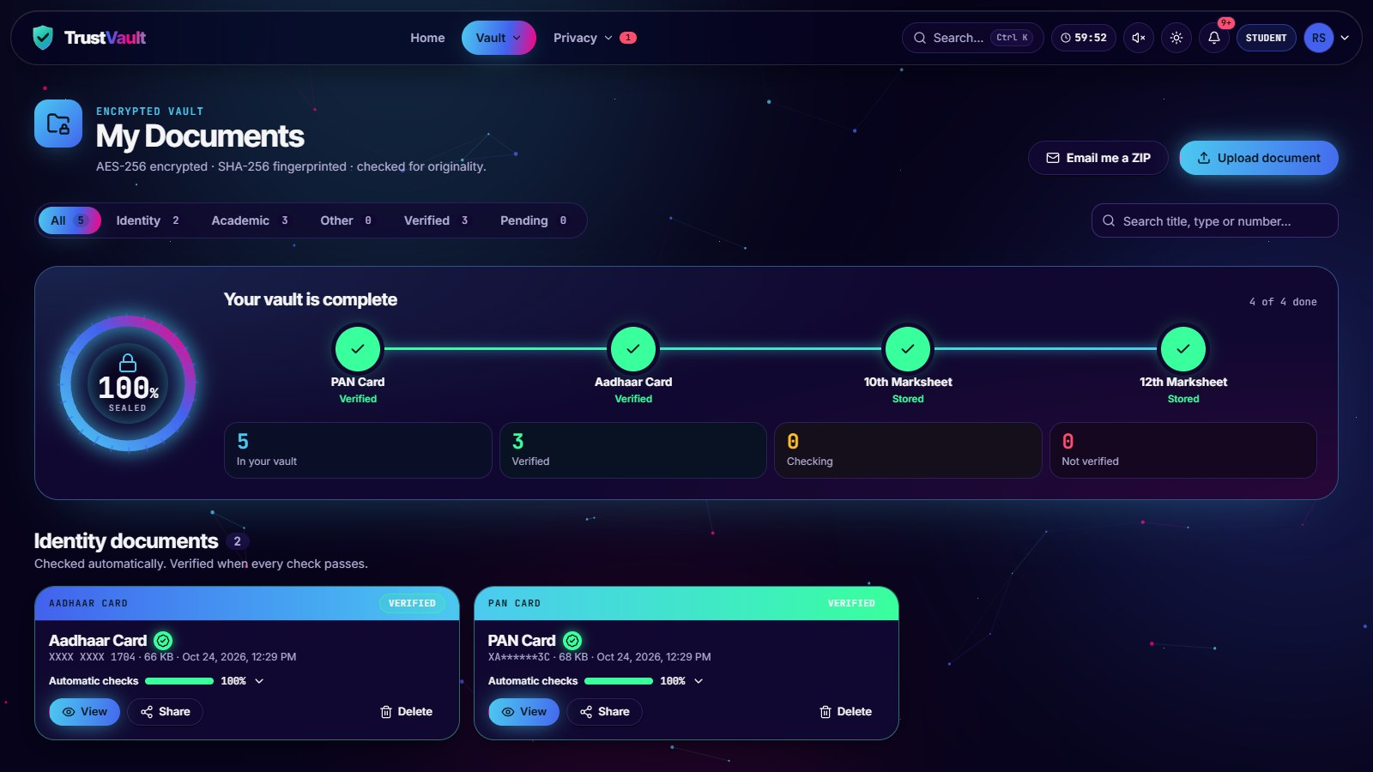
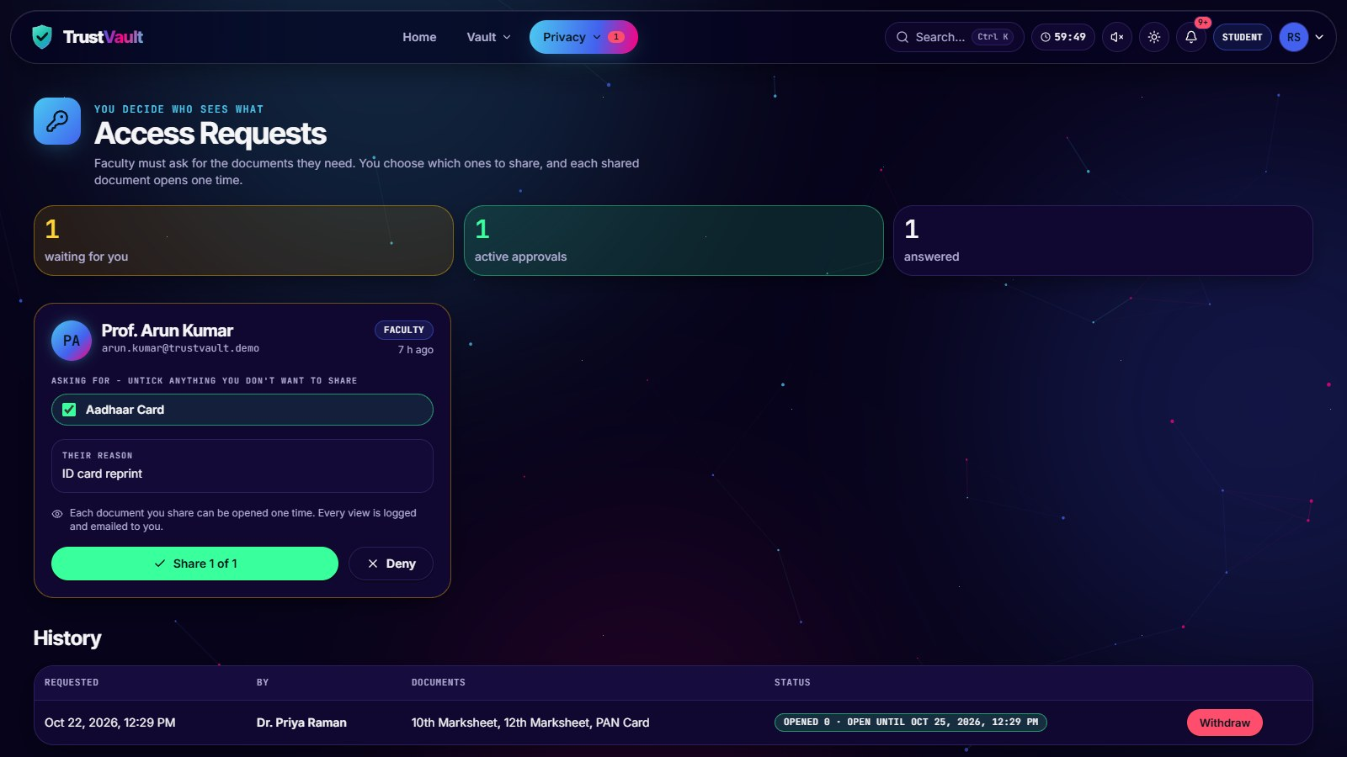
All UI Pages of the Project
THE INTERFACE · STUDENT · 2 OF 4
My Documents vault with check results
Student home vault progress, pending requests and recent activity
Access requests share all, some or none
Notes:
Student: Student home, vault progress, pending requests and recent activity; My Documents, vault with check results; Access requests, share all, some or none. These are screenshots of the running application.

Slide 12
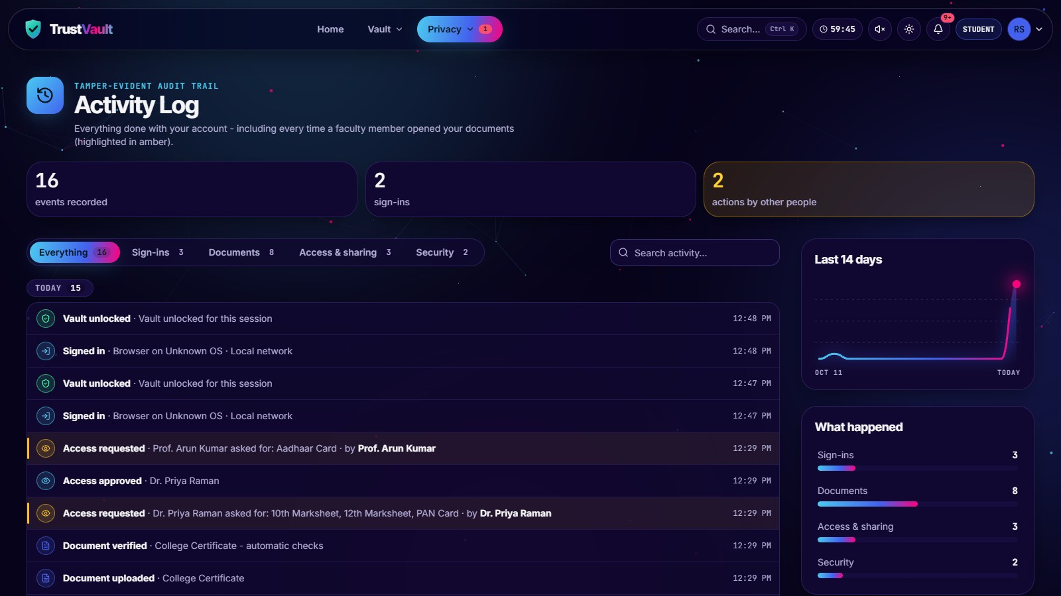
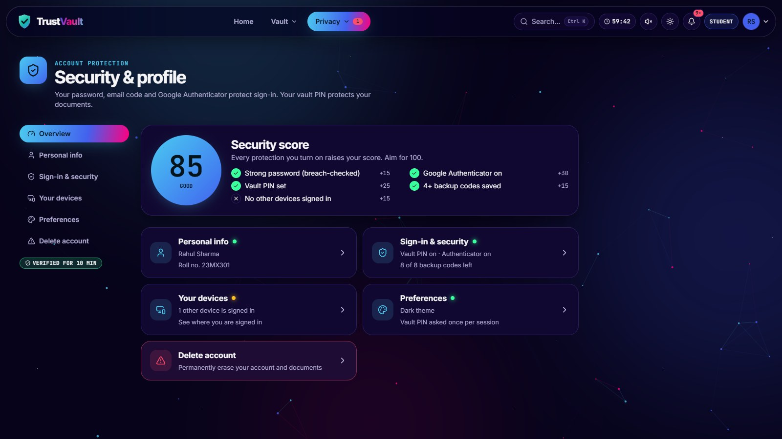
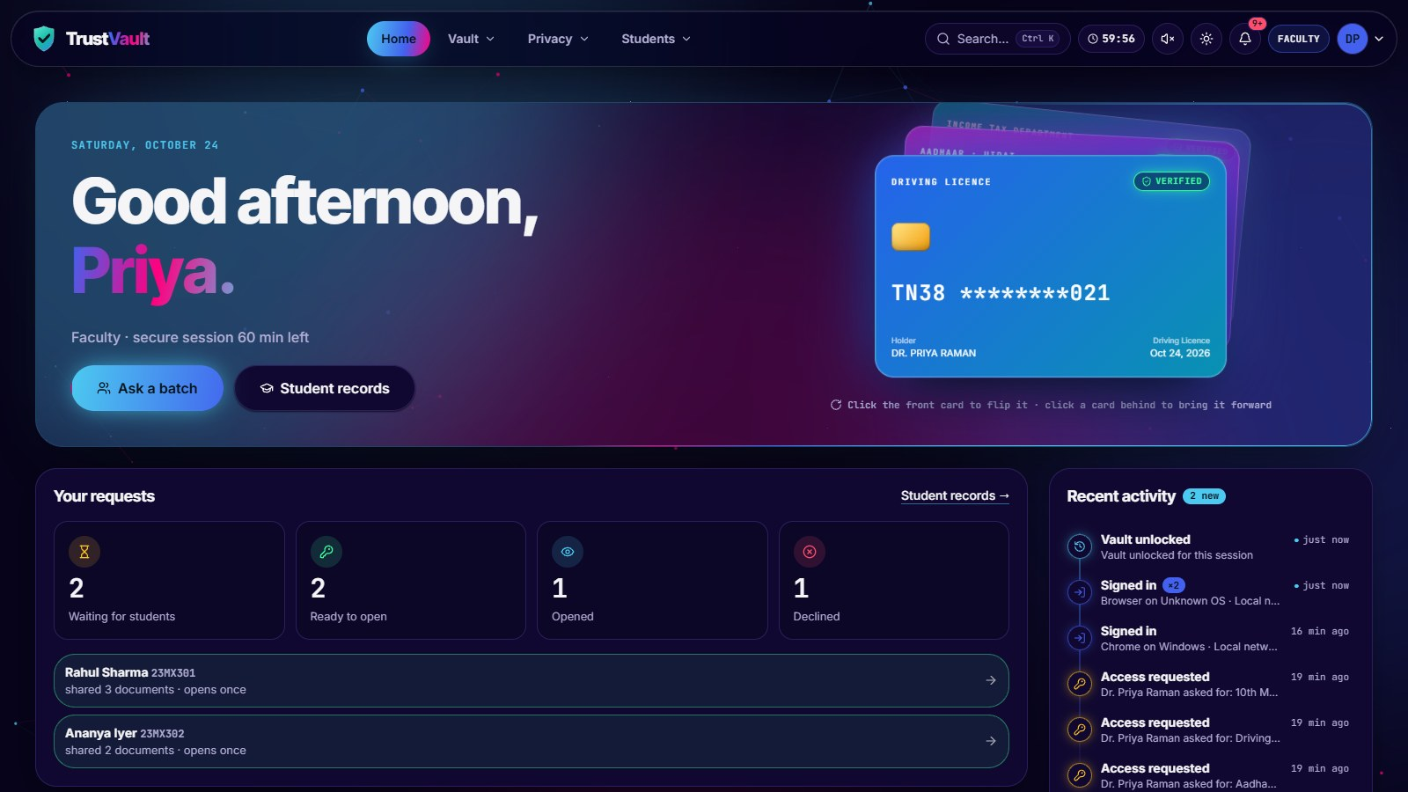
All UI Pages of the Project
THE INTERFACE · STUDENT AND FACULTY · 3 OF 4
Security & profile score, devices, PIN, 2FA
Activity log every event in the account, with filters and a 14-day chart
Faculty home requests and documents to open
Notes:
Student and faculty: Activity log, every event in the account, with filters and a 14-day chart; Security & profile, score, devices, PIN, 2FA; Faculty home, requests and documents to open. These are screenshots of the running application.

Slide 13
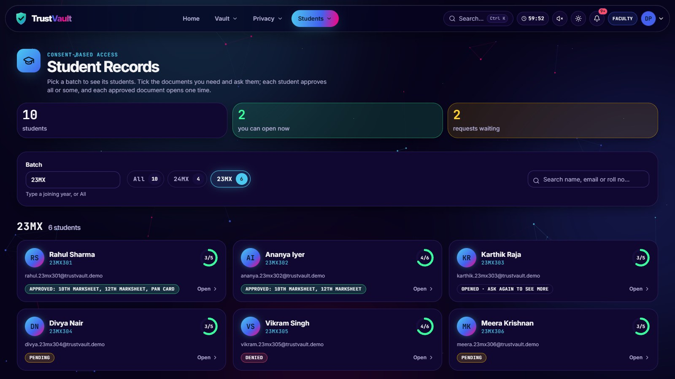
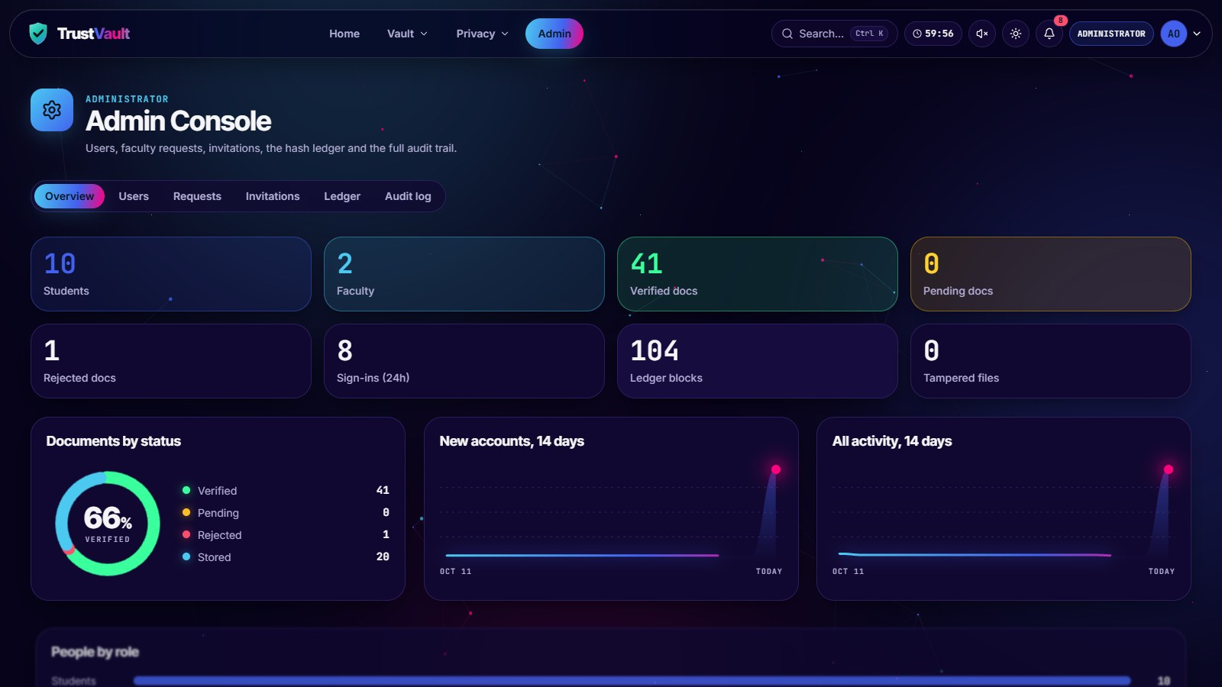
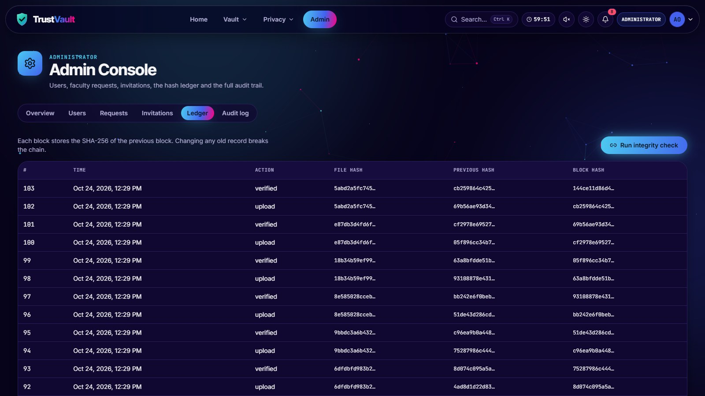
All UI Pages of the Project
THE INTERFACE · FACULTY AND ADMINISTRATOR · 4 OF 4
Admin console users, requests and charts
Student Records pick a batch such as 23MX and ask for documents
Hash ledger SHA-256 blocks, integrity check
Notes:
Faculty and administrator: Student Records, pick a batch such as 23MX and ask for documents; Admin console, users, requests and charts; Hash ledger, SHA-256 blocks, integrity check. These are screenshots of the running application.

Slide 14


Motion Graphics in the Interface
THE INTERFACE · IN MOTION
Built with
Three.js for the 3D vault
Motion and mo.js for UI animation
Respects reduced-motion settings
3D vault Three.js, drag to orbit
Hero ID card each check passes, then Verified
Kinetic headline each word of “Every check, one by one” swaps in a live check result
Notes:
The interface uses motion to explain the security checks: the main page has a live 3D vault built with Three.js, the hero ID card verifies itself step by step, and the headline animates word by word. These clips play during the slideshow.

Slide 15
Timeline of the Project: 8-Week Plan
8-WEEK PLAN
ACTIVITY
W1
W2
W3
W4
W5
W6
W7
W8
STATUS
Requirement Analysis
✓ Completed
UI/UX Design
✓ Completed
Database Design
✓ Completed
Frontend Development
✓ Completed
Backend Development
✓ Completed
Integration & Testing
✓ Completed
Bug Fixing & Optimization
✓ Completed
Documentation & Final Review
● In progress
7 of 8 weeks complete. Week 8, documentation and the final review, is in progress.
Notes:
This is our eight-week plan. Weeks one to seven are complete: requirements, UI and UX design, database design, frontend, backend, integration and testing, and bug fixing. Week eight, documentation and the final review, is in progress.

Slide 16


Conclusion
WRAPPING UP
TrustVault gives MCA students one encrypted, college-exclusive place for their identity and academic documents.
3
256
Automatic checks and a hash-chained ledger make verification faster, and every decision traceable.
sign-in factors
bit AES-GCM encryption
Consent comes first: faculty see only what a student shares, once, within 24 hours.
100
24 h
Future scope: other departments and colleges, and verified sharing with employers.
point automatic check
one-time access window
Notes:
To conclude: TrustVault gives MCA students one encrypted, college-exclusive place for their documents; automatic checks and the hash-chained ledger make verification faster and traceable; and consent comes first. In future it can grow to other departments and colleges, and to verified sharing with employers.

Slide 17
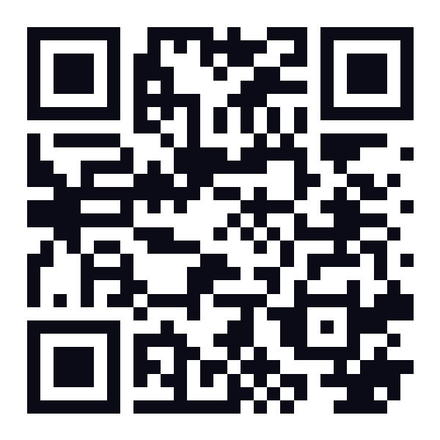
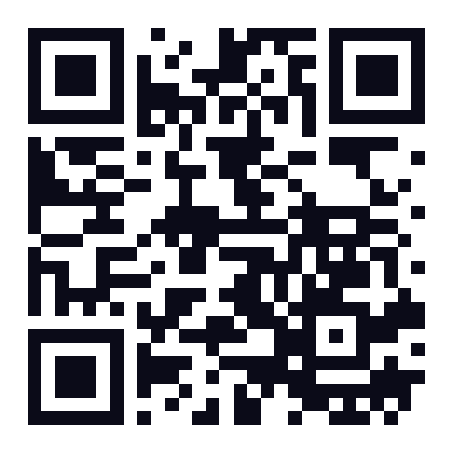
THANKS & SUGGESTIONS
Thank you
Your suggestions and questions are welcome
KIRUBHAKARAN K 26MX325
Live app
Source code
POOJA M 26MX337
trustvault-5lgg.onrender.com
github.com/renissshh/TrustVault
SRINITHISH J K 26MX347
Project Guide Dr. N. Ilayaraja
PSG College of Technology · Department of Computer Applications · 26MX17 Review 1
Notes:
Thank you for listening. We welcome your suggestions and questions. You can try the live application at trustvault-5lgg.onrender.com, and the source code is on GitHub at github.com/renissshh/TrustVault.

